Slide 1
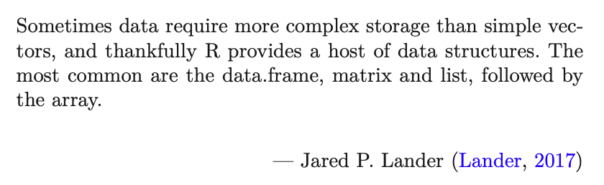
Data Science for Operational Researchers using R
04 – Data Frames and Tibbles
https://github.com/JimDuggan/Data-Science-for-OR

Slide 2
Course Overview
Topic | Description
 | Morning 1
1 | Introduction to R and Posit Cloud
2 | Atomic Vectors
3 | Functions, Lists and Functionals
4 | Data Frames and Tibble
5 | ggplot2
 | Morning 2
6 | Data transformation with dplyr
7 | Relational Data with dplyr
8 | OR Example 1 – Exploratory Data Analysis
9 | OR Example 2 – System Dynamics

Slide 3
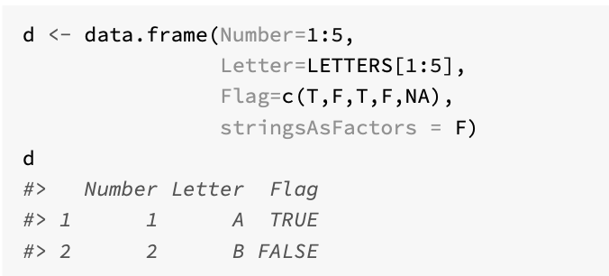
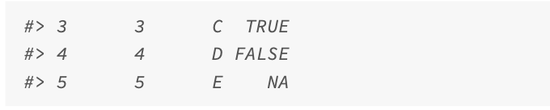
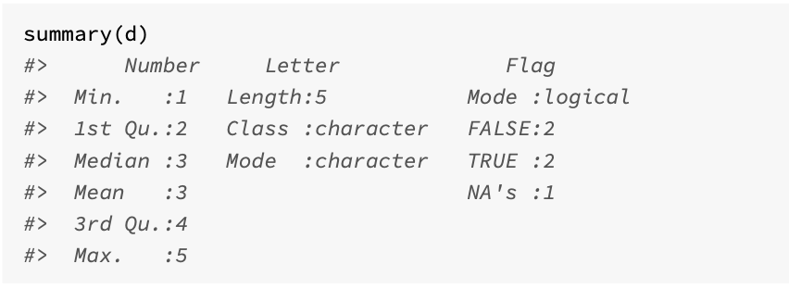
The data frame
A data frame is based on a list, where the elements of that list containing equal length vectors
The list elements then become columns in the data frame
Created with the function data.frame()
The data frame, with its row and column structure, will be familiar to anyone who has used a spreadsheet, where each column is a variable, and every row is an observation
It can also be operated on using matrix notation (a 2-dimensional vector)

Slide 4
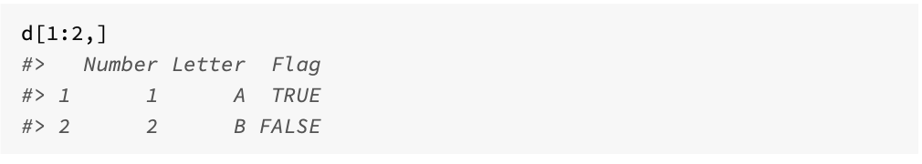
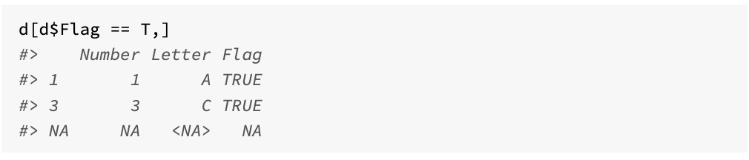
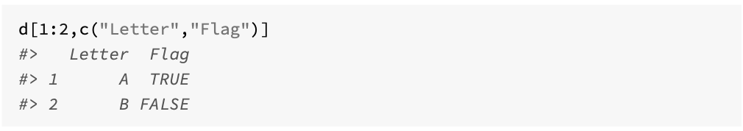
Subset examples

Slide 5
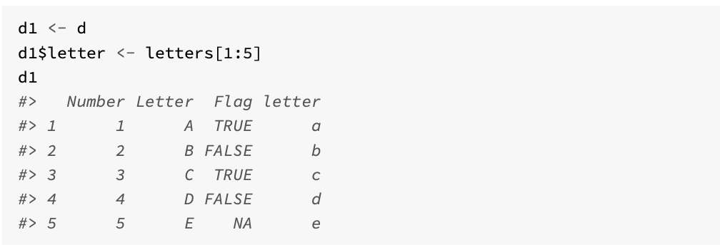
Adding columns (with $)

Slide 6
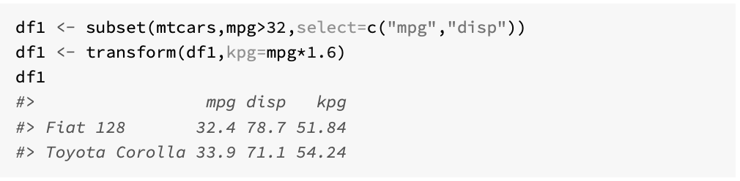
Adding columns using transform()

Slide 7
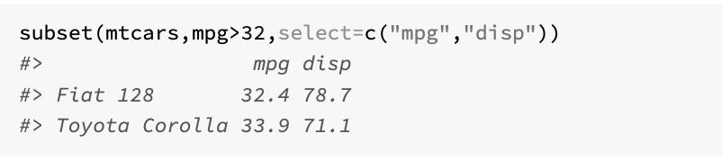
The subset() function
subset(x, subset,select) returns subsets of vectors, matrices or data frames which meet specified conditions.
The main arguments provided to this function when using with data frames are:
x, the object to be subsetted
subset, a logical expression indicating which rows should be kept
select, which indicates the columns to be selected from the data frame. If this is not present, all columns are returned.

Slide 8
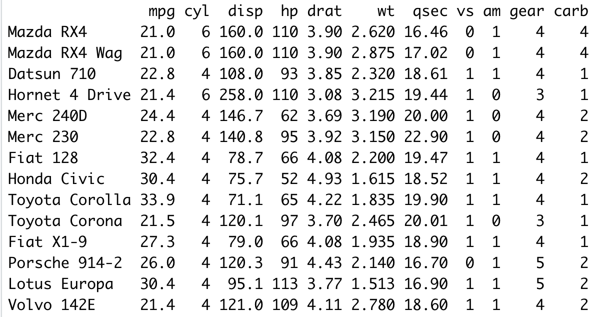
Challenge 4.1
Using the subset function to list all cars with an mpg greater than the mean from the data frame mtcars

Slide 9
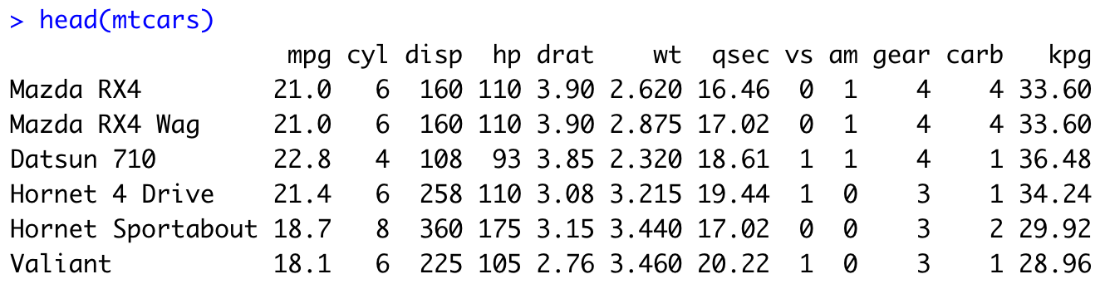
Challenge 4.2
Add a new column to mtcars (using $) that converts mpg to kpg. Assume a constant 1.6 for the transformation.

Slide 10
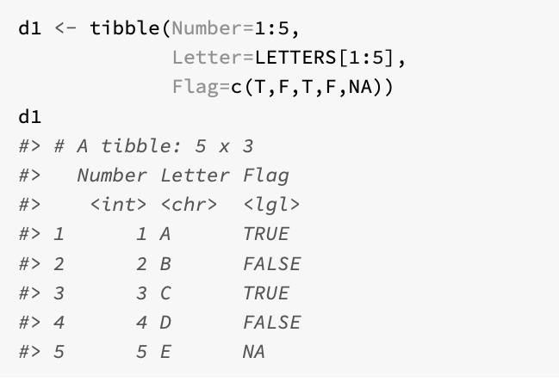
Introducing tibbles
Tibbles are data frames, however they alter some data frame behaviours to make working with packages in the tidyverse a little easier
Printing, where tibbles by default only show the first 10 rows, and limit the visible columns to those than fit on the screen
Subsetting, where a tibble is always returned, and also partial matching is not supported

Slide 11
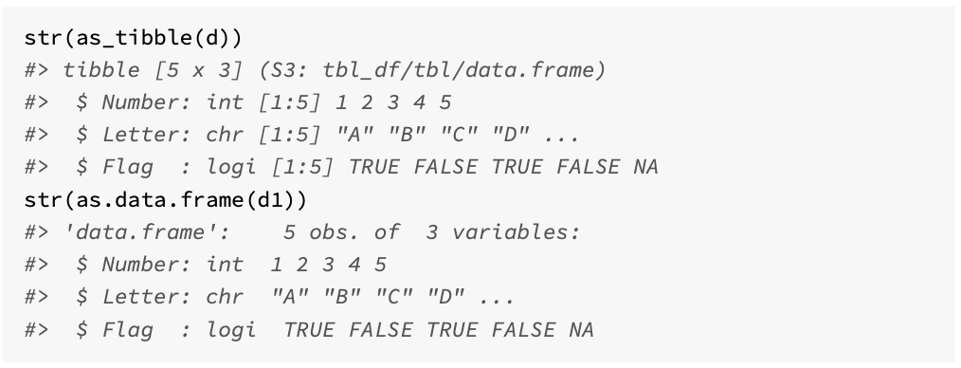
Moving between both

Slide 12
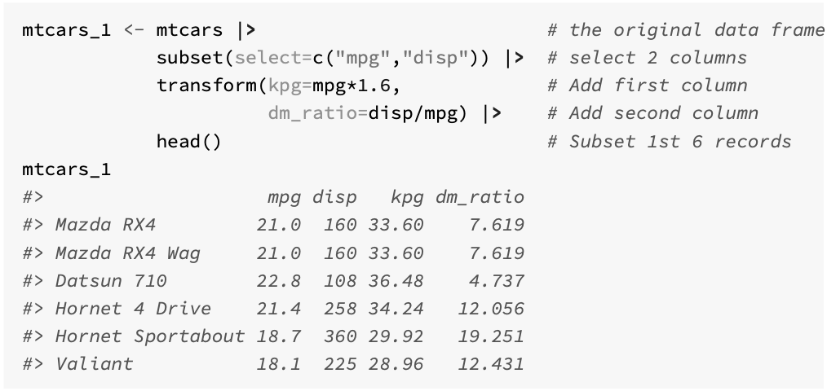
Using data frames in a pipeline

Slide 13
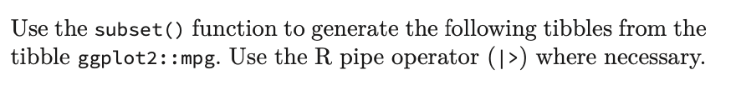
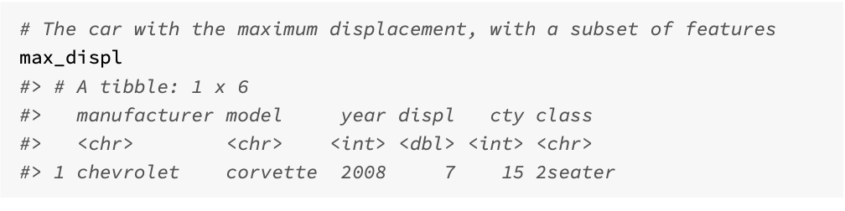
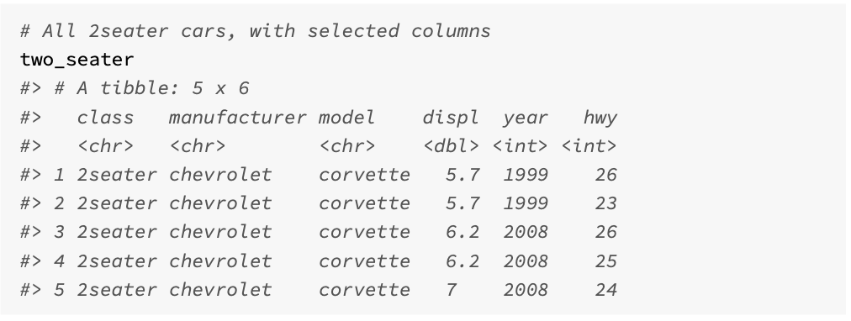
Challenge 4.3

